Slide 1
CLOUD-BASED STREAM PROCESSING DATA PIPELINE FOR REAL-TIME ANALYTICS FROM IOT-DEVICE DATA
Rakshokini Umasankar Indu Raju
Purushothaman Aravamuthan

Slide 2
PROJECT GOAL
Growth of IoT has necessitated to obtain valuable insights from massive amount of real-time data. IoT devices generates high-velocity continuous stream of data that needs analyzed real-time for monetizing data with business analytics.
Goal of this project is to
Build and demonstrate a fault tolerant architecture of data pipeline using cloud computing, that processes continuous stream of IoT data
Data from publicly available Industry 4.0 IoT sensors and devices has been used
Develop application for real-time analytics to identify patterns & behaviors from the data as they are produced

Slide 3
KEY CONCEPTS ADOPTED FOR IMPLEMENTATION
Concept-1: Serverless computing enable real-time analytics with flexibility to scale up elastic servers easily with increasing workloads
Concept-2: Stream processing systems is the next critical enabler for achieving the operational challenge of transmitting billions of datapoints per second as continuous streams of data workloads. This piece helps achieve the low latency requirement in real-time decision making
Concept-3: Data warehouse and data lake combines the power of relational and non-relational data stores into a single, cohesive architecture. Data must be processed, structured and stored efficiently in a way that allows complex queries to be executed in a rapid manner.
Concept-4: Real-time analytics helps generate insights immediately to decision-makers and allows automated execution of event driven queries that can be executed and sent back to devices to change their behavior without human intervention

Slide 4
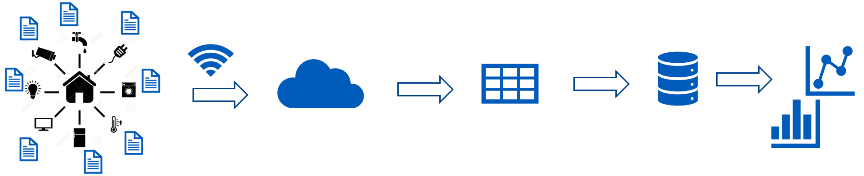



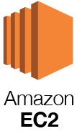
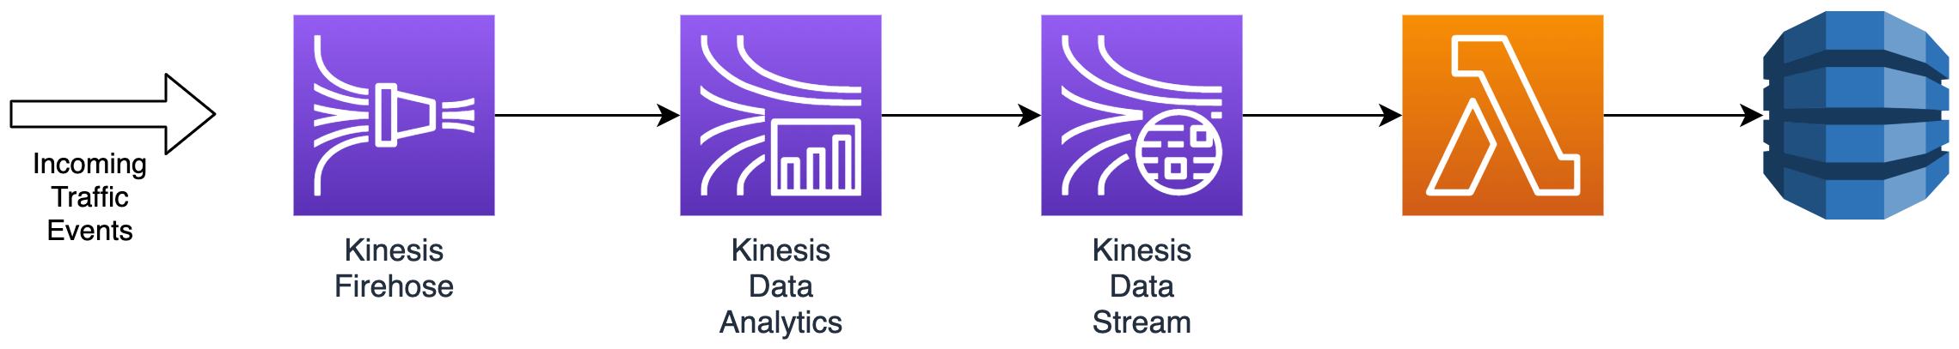
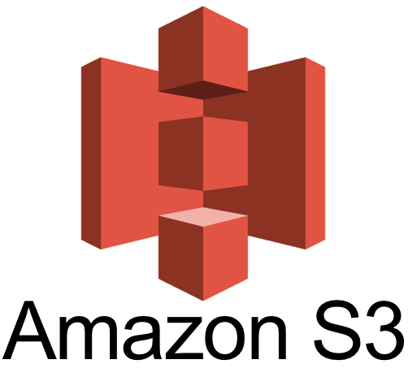
TECHNOLOGIES USED IN IMPLEMENTATION OF THE DATA PIPELINE
Cloud computing ecosystem: Amazon Web Services (AWS)
Serverless computing: EC2 – virtual servers with elastic balancing storage
Streaming data: Kinesis Firehose & Kinesis Data Stream – streaming data & transforming the incoming stream
Federated data storage: S3 & Redshift – Data lake object based storage & data warehouse
Real-time analytics: Athena & Quiksight – serverless query engine and business intelligence visualization tool

Slide 5
AVAILABLE STATE OF THE ART SOLUTIONS IN STREAM PROCESSING
Stream processing systems can be classified into open source and commercially available cloud solutions
Open source solutions – Storm, Spark Streaming, S4, Kafka
Commercial solutions – AWS Kinesis, Google MillWheel, IBM Infosphere
Storm is a distributed stream processing framework built upon the model of task parallel computation. It is optimized for low latency and adopts ZeroMQ to provide guaranteed message processing
Spark streaming is an extension of Spark, which is an in-memory distributed data analysis platform. It is built on the model of data parallel computation. Spark adopts micro-batch computation framework
S4 is based upon MapReduce which uses key based programming model. The processing is performed by elements and messages are transmitted in the form of data events
Kafka is the most popular open source distributed stream processing solution that uses columnar storage architecture, which is known to handle unstructured data streams very well

Slide 6
STATE OF THE ART IN STREAM PROCESSING ANALYTICS DATA PIPELINE
Amazon Kinesis is a cloud service that performs massive real-time streaming jobs, adapting to streaming data and performs load-balancing by auto-scaling. Fault tolerance is ensured by check-pointing to replay data records. It works on producers and worker model. Producer accepts data and converts into Kinesis stream and worker acts a client application, performing the streaming transformations
Google Millwheel is inspired from Map reduce programming model that allows users to write application logic in a directed computer graph using custom topology. Records in a Millwheel are continuously delivered along the edges in the graph.
IBM Infosphere is also used for large scale streaming jobs, that does not follow specific programming model. Stream processing language (SPL) is used for developing streaming applications. It allows users to create complex applications without focusing on intricacies of distributed execution

Slide 7
PRIOR ART – BATCH PROCESSING SYSTEMS
In the last decade, significant research has focused on creating MapReduce based big-data systems which was mainly engineered for batch processing of data in certain periodic intervals of time. It did not work well for real-time stream processing applications
One of the main challenges which needed the data analytics applications to move to stream processing systems is dynamic scalability and ability to perform transparent load-balancing for high volumes of data
Stream processing systems, fundamentally different from traditional batch processing systems requires
In-stream processing
Scalable with self load-balancing
High availability and persistent storage for short period of time (latency)

Slide 8
JUSTIFICATION FOR DATASET SELECTION
The primary objective for selection of this dataset is publicly available large source of structured streaming data, available from multiple sources of telemetry devices / sensors
Weather data from sensors
Home appliance devices data (fridge, garage door)
Application of this dataset could be used for advance home automation for energy savings. Based on ambient conditions and consumer usage patterns, the home appliances could be programmatically controlled
The available raw dataset has been processed in small batches of events, to mimic the streaming nature of the IoT devices as if they were sent directly from the sensors and devices themselves.

Slide 9
PROGRESS OF COMPLETION
Milestone # | Description | Activity | Status
1 | Streaming dataset preparation | Using Python to mimic streaming of data and landing in a server | Completed
2 | AWS cloud environment setup | Virtual server setup, network & security group config preparation | Completed
3 | Streaming system configuration | Kinesis data stream setup to receive data from EC2 server, Firehose setup | Completed
4 | Application development | Development of data pipeline integrating Kinesis with S3 datalake and integration with Athena for querying | Completed
5 | Analytics development | Integrate Quicksight with Athena and setup event triggers for dashboards | Ongoing
6 | Testing and deployment | End-end testing of the pipeline | Waiting on input

Slide 10
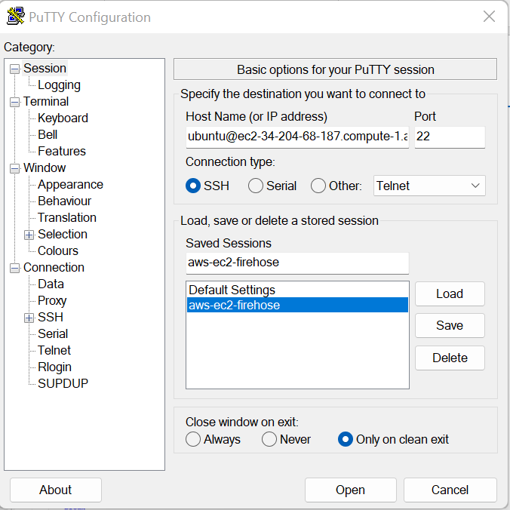
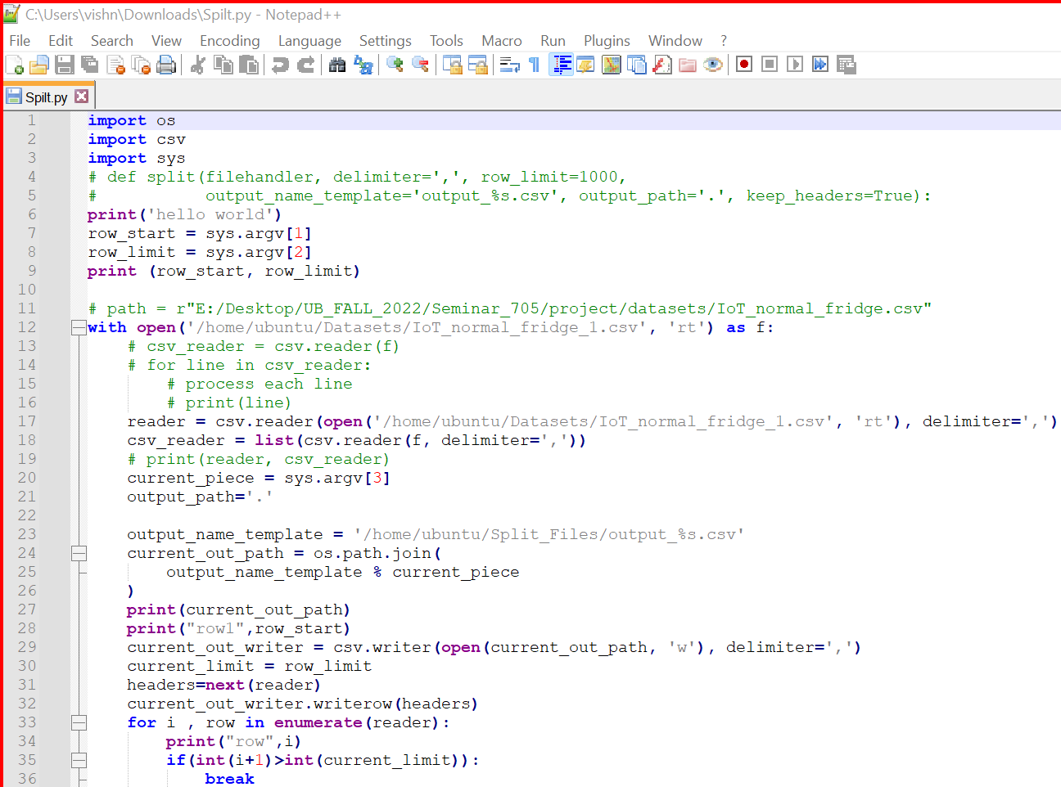
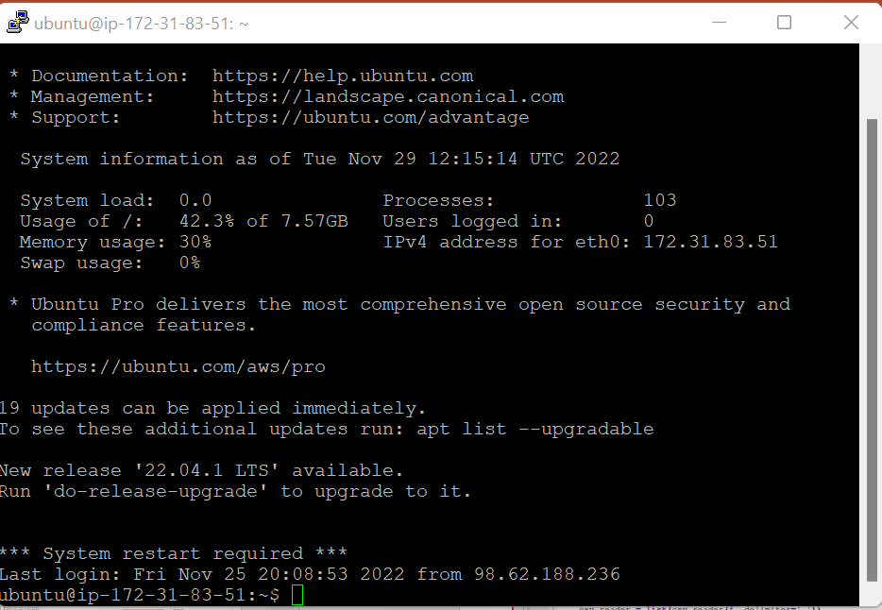
RESULTS

Slide 11
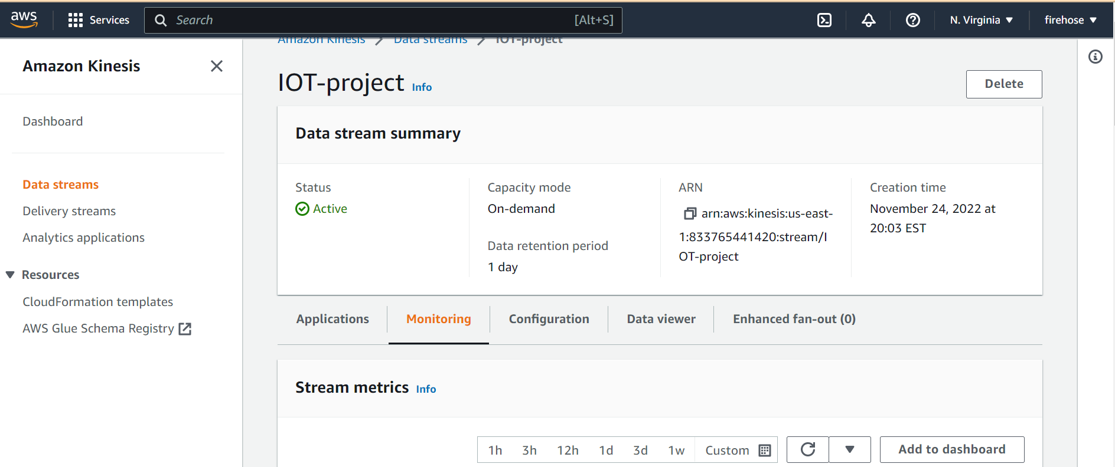
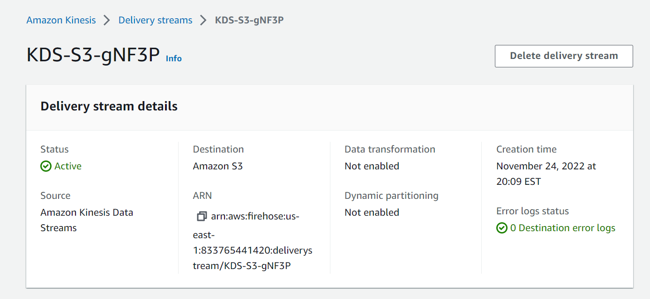
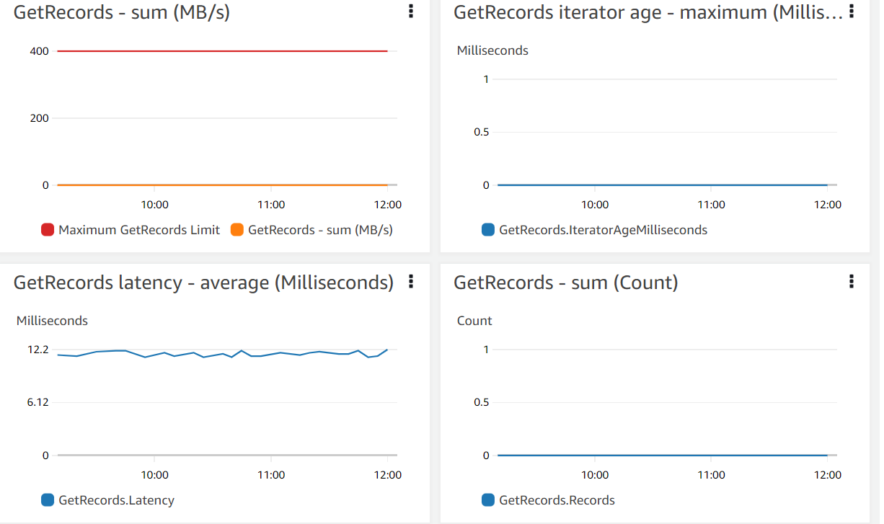
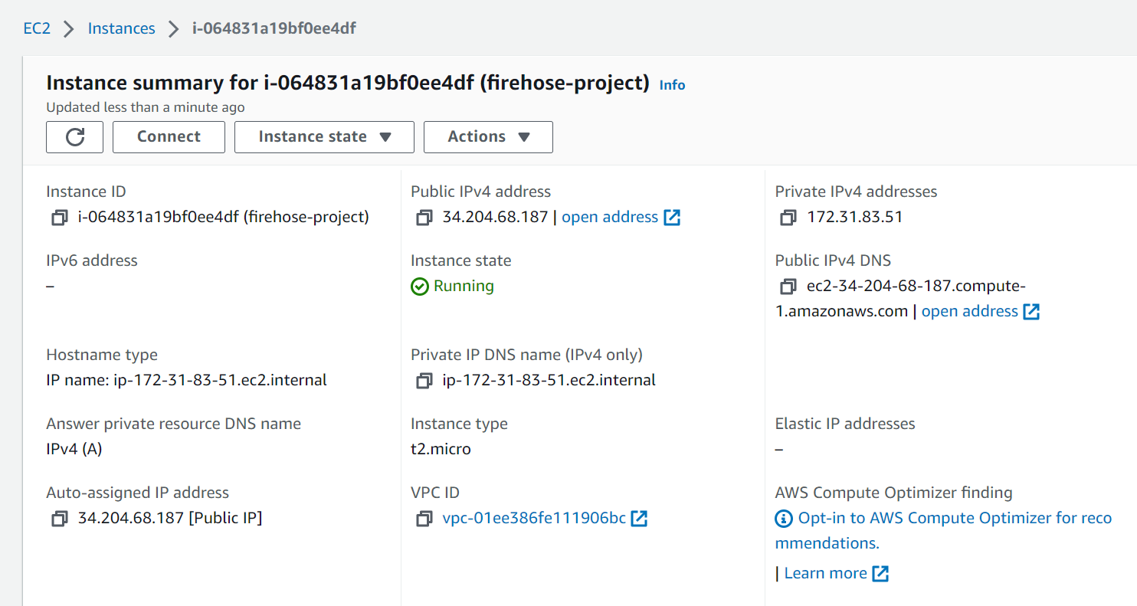
RESULTS

Slide 12
REFERENCES
Singh, M P., Hoque, M A and Tarkoma, S. “A survey of systems for massive stream analytics.” arXiv: Distributed, Parallel, and Cluster Computing (2016)
de Carvalho, O M., Roloff, E., and Navaux, P. “A Survey of the State-of-the-art in Event Processing.” 11th Workshop on Parallel and Distributed Processing (WSPPD) (2013)
L. Daldorff, S. M. Mohammadi, J. Bergman, B. Thide, A. Biem, B. Elmegreen, D. Turaga, O. Verscheure, and W. Puccio. Novel data stream techniques for real time hf radio weather statistics and forecasting. In Ionospheric radio Systems and Techniques, 2009.(IRST 2009). The Institution of Engineering and Technology 11th International Conference on, pages 1–3. IET, 2009
Amazon. Amazon Kinesis. http://aws.amazon.com/kinesis/.
Amazon. Amazon Kinesis Product Details. http://aws.amazon.com/kinesis/details/
Apache. Storm - Distributed and fault-tolerant realtime computation. http://storm.apache.org/.
C. Ballard. IBM Infosphere Streams harnessing data in motion. Vervante, S.l, 2010

